Slide 1
Employer support
Employer Forum 2022
Tim Hillman
Employer Engagement Manager

Slide 2
Employer Forum 2022
ABS Project
Revamped Newsletters
Employee/Employer Training
Website Content
Comms Manager appointed
Employer Engagement 2022
Annual Allowance data
McCloud Project
Contribution reconciliation
Accounting Reports (FRS102/IAS19)
i-Connect onboarding

Slide 3

Training
Employer Forum 2022
In the second half of 2022 the Fund began to offer training to both employers and their employees
Brighton & Hove City Council, East Sussex College Group, Wealden District Council, East Sussex County Council, Rye College, RPMT (soon)
432 attendees to date over 10 training sessions

Slide 4

What did we cover?
Employer Forum 2022
Pensions basics - defined contribution v defined benefit schemes
LGPS key features – overview
Joining/transfers in
‘My Pension’ – member self-service
Contributions – amounts/tax/paying more or less
Pensionable pay
CARE scheme – how it works
Previous LGPS schemes – summary
Leaving
Death in service
Retirement – Active/Deferred/Early/Late - case studies

Slide 5
Feedback
Employer Forum 2022

Slide 6

Training 2023
Employer Forum 2022
In addition to LGPS specific training we are also looking to build in some financial education elements as part of these courses
Looking to introduce modular training courses:
- New joiners
- Under 50s
- Over 50s
- Leavers
- Pensioners
- Retirement

Slide 7

Cost of Living Crisis
Employer Forum 2022
Opting Out
50/50 scheme
Tax savings
Long-term stability
Inflation rates
How to support employees going forward

Slide 8
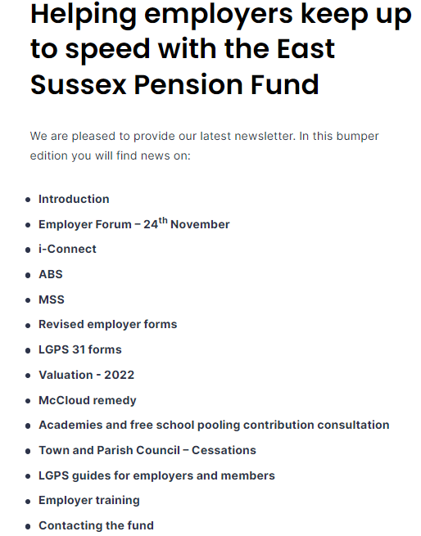

Newsletters

Slide 9
Newsletters
Employer Forum 2022
New format seems to streamline the information employers can look at.
Employers can focus on the topics that are most important to them.
New for 2023 – Shorter more regular updates. New methods of sharing information – Video’s, Social Media, Webinars,

Slide 10

2023 - Plan
Employer Forum 2022
i-Connect to be fully onboarded and new team to establish strong monthly process
To roll out a suite of training topics to support and help employers and employees.
Improve engagement with employers, with site visits and regular drop in sessions
Shorter more regular updates. New methods of sharing information – Video’s, Social Media & Webinars,

Slide 11
Questions?
Employer Forum 2022

