Slide 1
Pension Board update
Employer Forum 2022
Ray Martin
Chair of Pension Board

Slide 2

Role of the Pensions Board
Employer Forum 2022
To assist the scheme manager to comply with the scheme regulations and other legislation relating to the governance and administration of the scheme and any requirements imposed by the regulator.
To report any material breaches of scheme regulations or legislation to the regulator (including those breaches made by employers)

Slide 3
Focus of the Board in 2022
Employer Forum 2022
To provide input from the perspective of members and employers into administration and governance matters of the Pension Fund
To help drive the improvement in communications between the Scheme Manager, the Pensions Administration Team (PAT) and Participating Employers.
To continue to improve data quality of members records held to ensure effective administration of Pensions and high reliability of records. To support the implementation of i-Connect to enable provision of monthly data by employers.
To help drive the improvement in communications between the PAT and scheme members
To work with Officers to provide regular employer communications
To ensure all Members receive their annual benefit statements within Statutory requirements.

Slide 4
Importance of accurate data
Employer Forum 2022
Better outcomes
Informed
decision making
Data quality
Employers Administering Actuaries Authority
Actuaries
Employers
Accurate contributions rates
Members
Accurate benefit estimates and calculations

Slide 5
i-Connect employer onboarding
Employer Forum 2022
90 employers onboarded now.
Hopeful all employers onboarded by March 2023

Slide 6
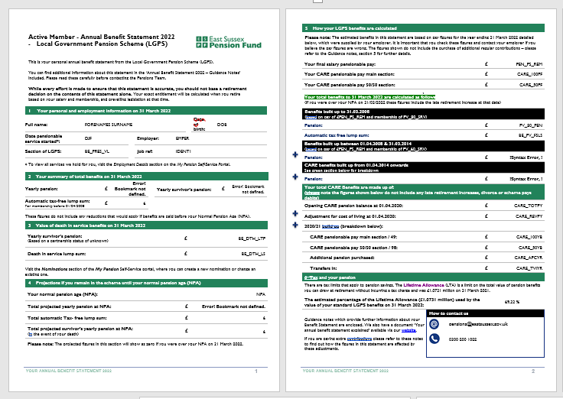
2022 Annual Benefit Statements
Employer Forum 2022
The final summary statistics at the 31 August 2022 statutory deadline are shown below
*BHCC excluded from figures quoted (data issues)
ABS year | Deferred members | Active members
2022 | 99.79% | 96.72% *

Slide 7

Pension Board focus for 2023
Employer Forum 2022
In 2023 the Pensions Board will focus on helping the Scheme Manager with:
Continued Data Improvement, including the roll-out of i-Connect
Improved communications to both Employers and members
More accessible resources for Employers and members
Improved engagement

Slide 8
Questions?
Employer Forum 2022

